Slide 1

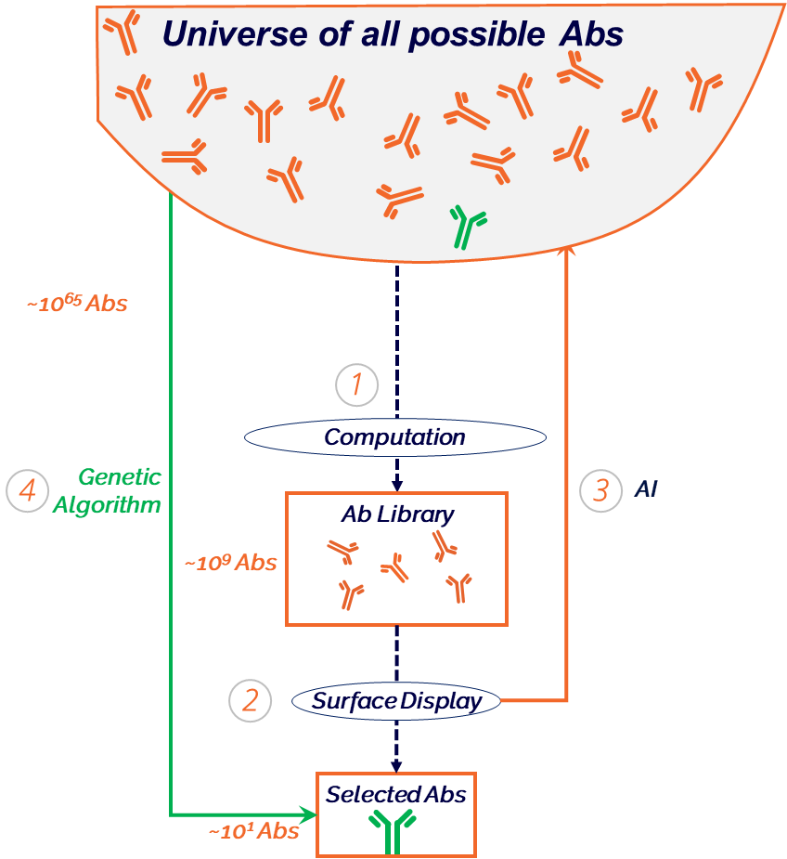
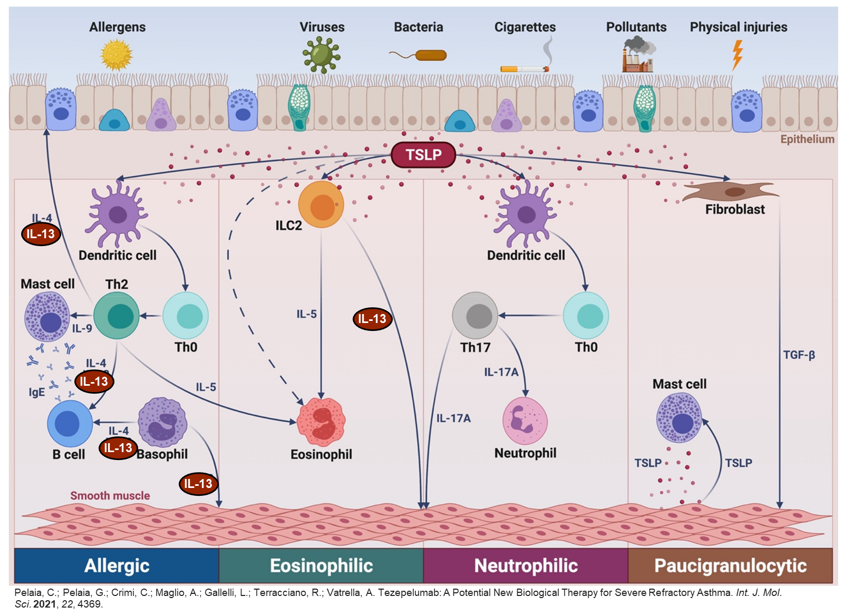
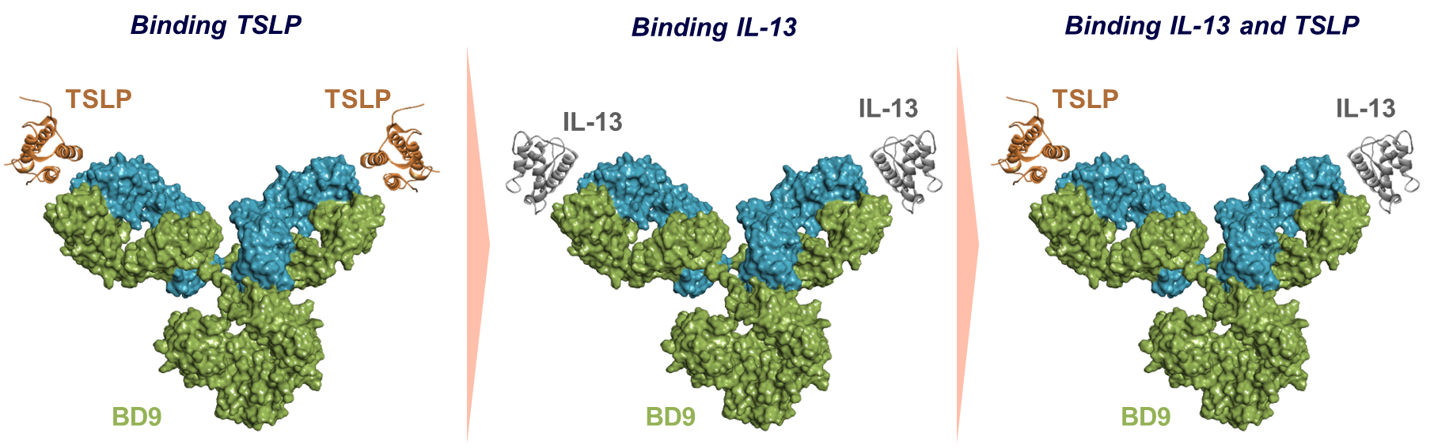
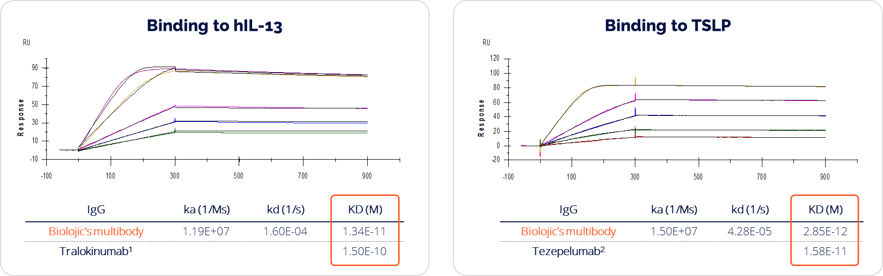
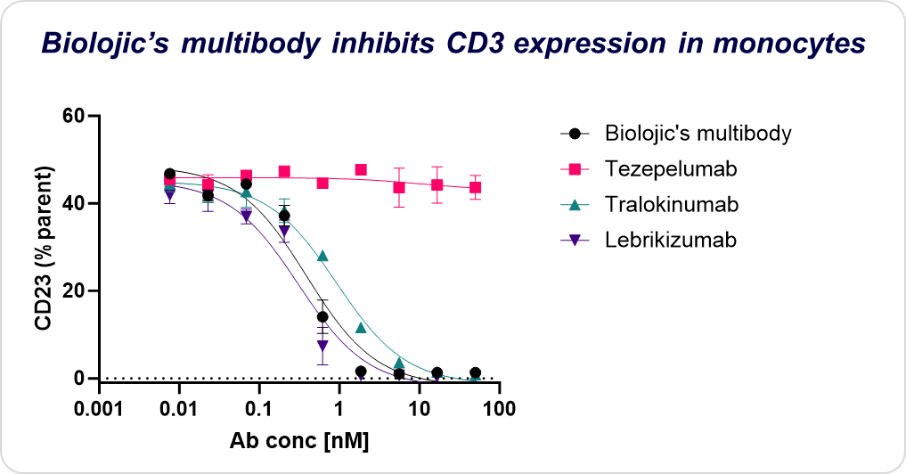
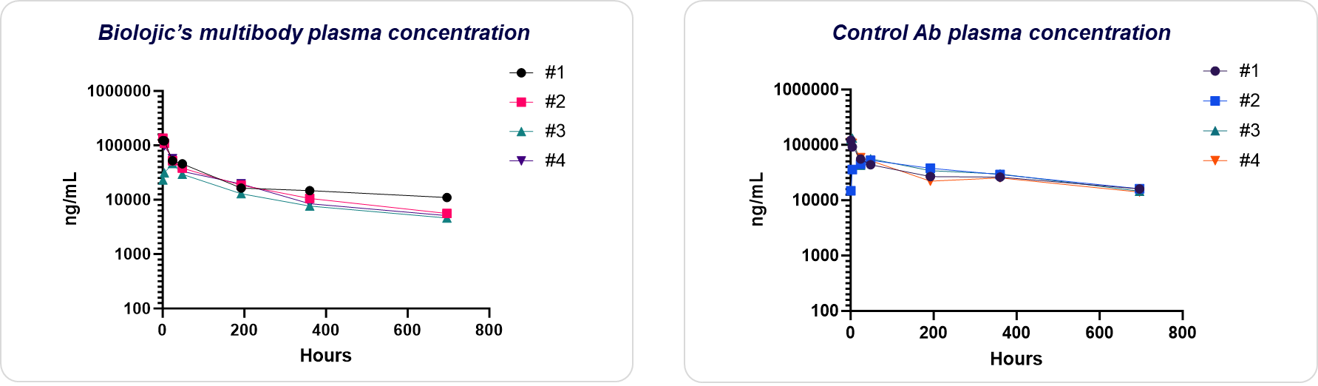
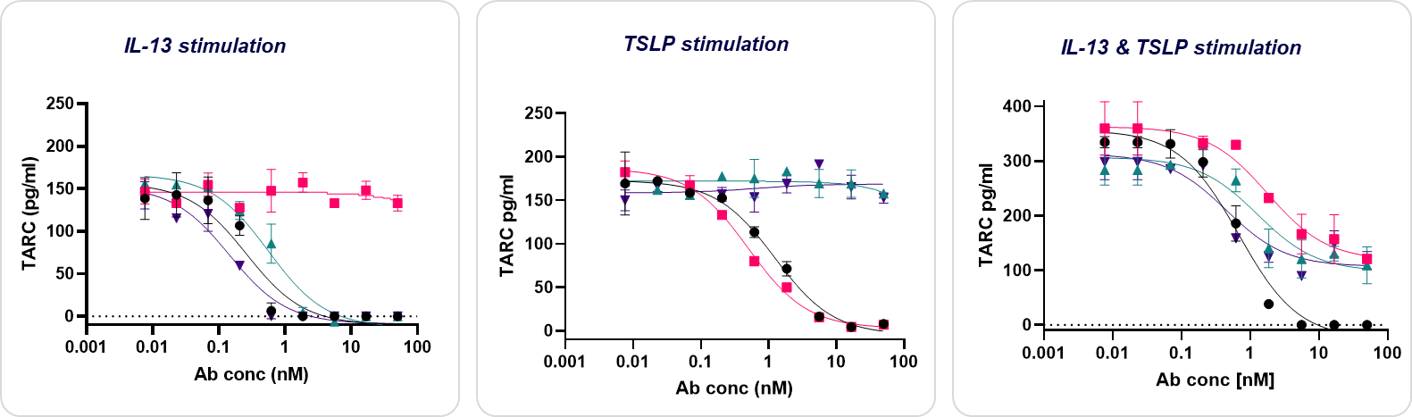
A Novel Computationally Designed Multibody Targeting IL-13/TSLP
for Precision Therapy in TH2-Mediated Diseases
Yael Diesendruck¹, Alik Demishtein¹, Reut Barak Fuchs¹, Michael Zhenin¹, Guy Nimrod¹, Sharon Fischman¹, Alexey Shnyder¹, Hadar Gattengo¹, Itzhak Meir¹, Liron Danielpur¹, Olga Bluvshtein¹, Morya Ifrach¹,, Avi Haleva¹, Tomer Shlamkovich¹, Ayelet Chen¹, Nikol Malchenko¹, Dvora Grunberg¹, Shmuel Berenshtain¹, Noam Grossman¹, Tal Vana¹, Yair Fastman¹, Jessica Mioduser¹, Yehezkel Sasson¹, Inbar Amit¹, Tim Wyant¹, Ronald Herbst¹, Yanay Ofran^{1,2}
¹ Biolojic Design, Ltd. Rehovot, Israel. ² The Goodman Faculty of Life Sciences, Bar Ilan University, Ramat Gan, Israel.
Introduction
We are redefining what antibodies can do
Biolojic has designed a multibody that binds two cytokines, IL-13 and TSLP, with the same Fab domain. Multibodies are fully human IgG antibodies that maintain a natural symmetrical format but can specifically bind two or more targets. Here we present a multibody that binds two cytokines that play a key role in Th2 immunity. TSLP is an ‘upstream’ cytokine, secreted upon exposure to allergens/triggers by dendritic cells, leading to downstream signaling cascade that leads to secretion of IL-13 by ILC2 cells, macrophages and CD4⁺ T cells. IL-13 further promotes Th2 immunity responses to promote inflammation. Targeting both upstream and downstream cytokines involved in the Th2 immunity process has the potential to alleviate Th2-mediated diseases such as atopic dermatitis and asthma.
Figure 2. Biolojic’s innovative AI approach: perform one in-vitro generation, and let AI do the rest in-silico
Libraries are designed to be good training sets, rather than to contain good solutions​
Selections are done to measure Ab properties (affinity, stability, specificity, etc.) rather than to select specific Abs​
​Per-property models are trained on selections data ​
Genetic algorithms (GA) are used to search a huge sequence space, in silico, for variants that fulfill all properties
A.
Multibody mode of binding
B.
C.
Figure 1. Role of IL-13 and TSLP in allergic diseases. Upon exposure to allergens and other environmental factors, TSLP promotes the differentiation of Th2 lymphocytes secreting IL-4, IL-5, IL-9, and IL-13. In turn, IL-13 effects B cells, eosinophils, and mast cells. Independently of TSLP, basophils secrete IL-13 and IL-14.
Figure 3. Schematic Illustration of Biolojic’s multibody mode of binding. Multibodies are designed to bind different targets under different conditions. Here we present a multibody that can bind TSLP with both arms [A], or IL-13 with both arms [B], or IL-13/TSLP simultaneously [C]. The binding is modulated by time, location, and cytokine concentration.
Results
Binding kinetics
A.
B.
Figure 4. Binding kinetics to hTSLP and hIL-13 is similar to those of two clinical monospecific benchmarks as measured by SPR. Binding of Biolojic’s multibody to hIL-13 with an affinity of 13.4pM, compared to affinity of anti IL-13 tralolkinunmab (0.15nM) [A]. Binding of Biolojic’s multibody to hTSLP with an affinity of 2.85pM, compared to affinity to anti TSLP tezepelumab (15.8pM) [B]. SPR was performed by capturing the antibody onto an anti-hFc precoated CM5 chip, and a serial dilution of IL-13/TSLP was injected in a multi-cycle strategy.
1. Benchmark value was taken from: Thom, G. et al. Proc. Natl. Acad. Sci. U. S. A. 103, 7619–7624 (2006).
2. Benchmark value was taken from: NDA/BLA Multi-disciplinary Review and Evaluation {BLA 761224} {Tezspire/Tezepelumab}
Figure 6. Downregulation of IgE receptor CD23 by Biolojic’s multibody is comparable with IL-13 targeting benchmarks. hPBMCs were stimulated for 48h with IL-13 alone and treated with tested Abs. As expected, the anti-TSLP benchmark Ab (Tezepelumab) had no effect, while anti IL-13 benchmark Abs (lebrikizumab and tralokinumab) and Biolojic’s multibody lower CD23 expression in a comparable dose-dependent manner. CD23 expression levels in monocytes are presented as percentage of the parental population (CD14+ cells).
Pharmacokinetics profile
Antagonistic effect on IL-13 and TSLP in primary cells
A.
B.
The biological effect of TSLP and IL-13 is monitored by measuring the levels of two biomarkers:
TARC-mediated recruitment of Th2 cells and CLA+ CD4+ T cells plays a key role in allergic diseases. TARC serves as a clinical biomarker for atopic dermatitis severity as well as efficacy of treatment. Both IL-13 and TSLP directly upregulate TARC production by dendritic cells.
CD23 (FcɛRII) is the "low affinity" receptor for IgE. Stimulation of PBMCs with IL-13 induces expression of CD23 in B cells and monocytes.
T1/2 = 15.7 days
T1/2 = 17.2 days
Figure 7. Biolojic’s multibody pharmacokinetics profile in rats. Biolojic’s multibody [A] and vedolizumab as a control antibody [B] were administered to Sprague−Dawley rats in 0.5mg/Kg (n=4 per group). Ab concentration at tested time points are presented for each animal. Biolojic’s multibody shows a typical PK profile with a rapid distribution phase and a slower elimination phase, similarly to the control Ab.
A.
B.
C.
Conclusion
Multibodies, symmetrical IgG antibodies with dual targeting, are a novel therapeutic modality developed using Biolojic Design's unique computational methodologies.
Here we present a multibody targeting IL-13 and TSLP with high affinity to both cytokines.
By effectively attenuating CD23 expression on monocytes and completely inhibiting TARC secretion, Biolojic’s multibody showcases potent biological activity.
Moreover, favorable pharmacokinetic attributes observed in rat models together with its robust developability profile (including stability under diverse stress conditions, optimal thermostability, high purity, and yield), underscores its potential as a promising therapeutic agent.
Biolojic’s multibody emerges as a compelling candidate for addressing TH2-mediated disorders like atopic dermatitis and asthma.
Figure 5. Biolojic’s multibody completely downregulates TARC levels in IL-13 & TSLP stimulated hPBMCs, while mono-targeting benchmark Abs demonstrates partial inhibition. hPBMCs were stimulated for 48h with either IL-13 [A], TSLP [B] or with the combination of both cytokines [C]. Following stimulation, cells were treated with tested antibodies: Biolojic’s multibody was compared to an anti-TSLP Ab (Tezepelumab) and to anti IL-13 Abs (Tralokinumab and Lebrikizumab). TARC levels in the supernatant were measured by ELISA. Stimulation with a single cytokine resulted with a comparable full inhibitory effect, while only Biolojic’s multibody demonstrates full inhibition of TARC levels when cells were stimulated with both cytokines.

